Slide 1

CUSTOMER CHURN PEDICTION PROJECT
BONIFACE MUTWIRI KIMUTAI

Slide 2
OVERVIEW.
Business growth and development remains a central motivator in organizational decision making and policy making. Although every business leader aspires to achieve growth in revenues, clientele and profitability, they must try as much as possible to avoid making losses.
In recent years, such leaders, as well as business experts, have identified customer satisfaction as an important factor to ensuring such growth and development. Without customers, a business would not make any sales, record any cash inflows in terms of revenues, nor make any profits. This underscores the need for organizations to implement measures that retain existing customers.

Slide 3
Business understanding.
The telecommunication industry has become a very competitive one, particularly with emerging technological innovations which has given customers alternative communication channels.
I aim to create a predictive business model which would enable it to adapt strategies that would reduce churn, maintain and grow it’s customer base , in a bid to sustaining overall growth and profitability.

Slide 4
Business queries.
What are the best machine learning models for forecasting client attrition?
What tactics can the telecom provider use to keep clients and lower attrition rates ?
What are the best machine learning models for forecasting client attrition ?
Which factors are the most important indicators of client attrition for the telecom provider ?

Slide 5
DATA UNDERSTANDING.
The telecom dataset contains information about customer activity in relation to churn.
It contains a total of 21 columns and 3333 rows. Each row having a unique identifier as the telephone number.
It contains both numerical and categorical values.
The data is basically a binary classification problem.
There are no missing values and duplicates.

Slide 6
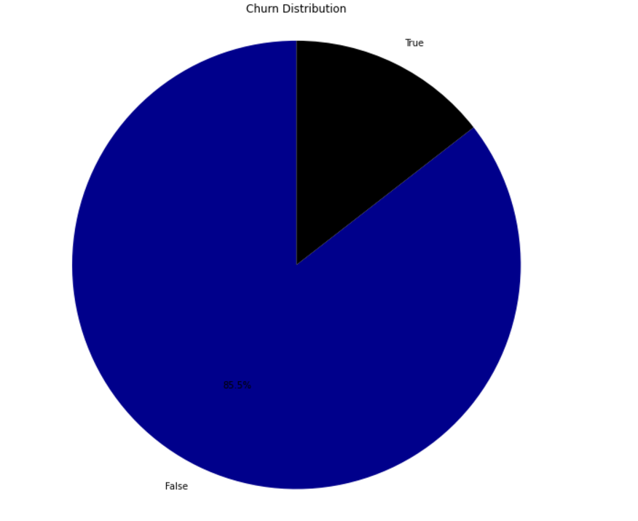
EXPLANATORY DATA ANALYSIS.
Of the 3333 customers in the dataset, 483 have terminated their contract with the telecom firm. That is 14.5% of the customers lost.
TRUE – CHURNED.
FALSE – NOT CHURNED.

Slide 7
MODELING.
Three different models were made for the churn prediction and further improvements were made to achieve the best predictive results. They include:
Logistic Regression Model.
K- Nearest Neighbors.
Random Forest Classifier.

Slide 8
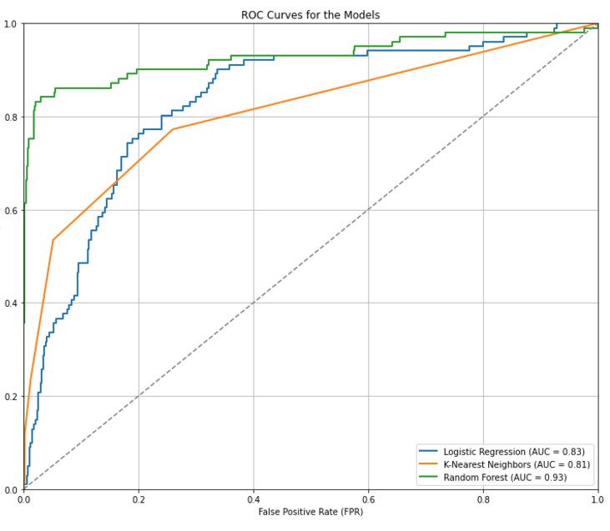
MODEL PERFORMANCE
The Random Forest Classifier was the Best Model.

Slide 9
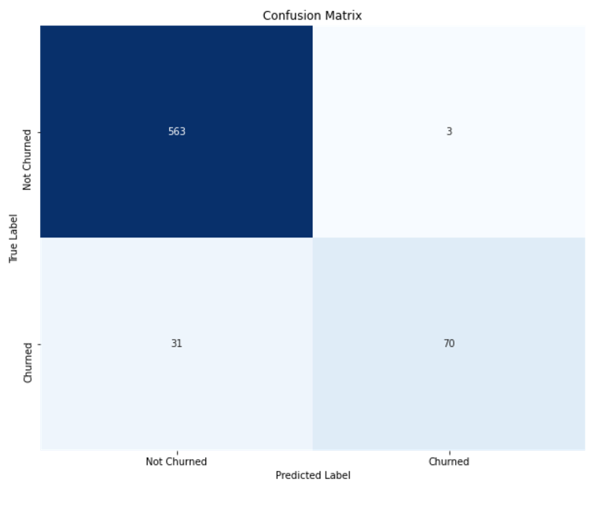
Random forest classifier.
The model was able to achieve:
Precision : 95.89%
Accuracy : 94.37%
Recall : 69.3%
F1 score : 80.46%

Slide 10
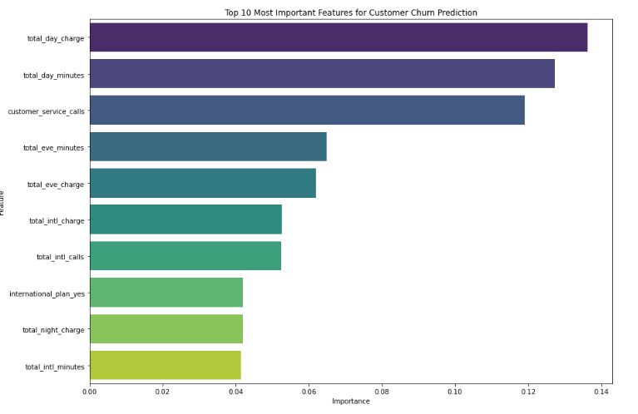
FEATURE IMPORTANCE.

Slide 11
RECOMMENDATION.
The telecom company should make use of the Random Forest Classifier as the primary model predicting customer churn.
Customer Retention strategy that addresses key features in relation to call minutes and charges. These Efforts could include personalized offers.

Slide 12
Thank you !
I wish to thank my TM for the guidance and support as well as my fellow classmate for everything they have done for me.
TM- MaryAnn Mwikali.
Name- Boniface Mutwiri Kimutai

